Slide 1

Cycle Safety
Will you help I.M.P.S. to keep your younger brothers and sisters safe?
#safetoys

Slide 2
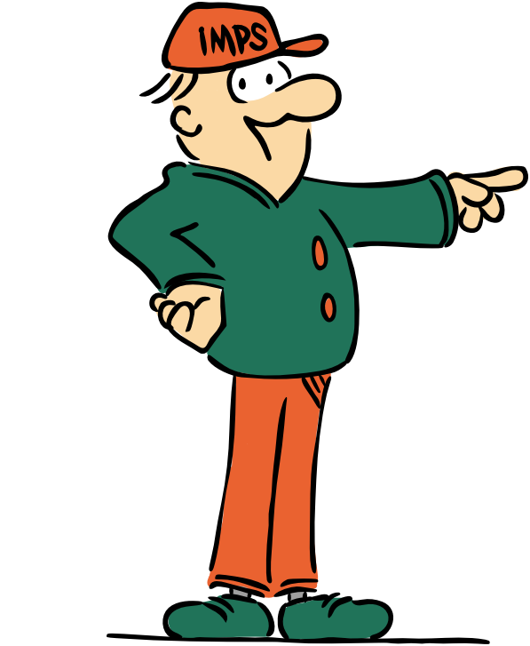
Welcome to the I.M.P.S. team!
Now you are in year 6 you automatically become a member of the I.M.P.S. team!
I.M.P.S. is a special programme that teaches you how to be responsible for the risks you take and how to make them safer. It also teaches you what to do in an emergency.
Every month we are going to give you an I.M.P.S. mission to complete. We would love it if you let us know what you do at your school and send us some images.
Find out more about I.M.P.S. at www.impsweb.co.uk Your teacher will do some lessons with you and book a visit from our I.M.P.S. trainers to teach you lots of useful emergency skills.

Slide 3
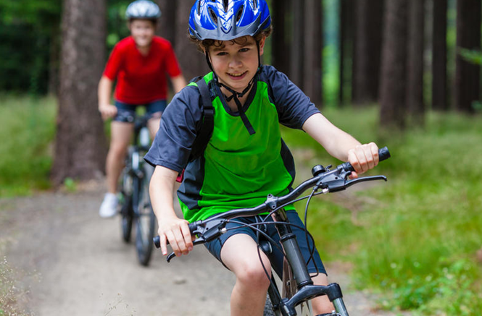

Cycle safety
Now the evenings are getting lighter and the weather is improving, you might be thinking about getting your bike out if you are lucky enough to own one.
Here at I.M.P.S. we want you stay as safe as necessary and not as safe as possible.
Does that make sense?
What we mean is that we still want you to take risks which are part of learning about life and having fun, but we want you to take safer risks and reduce potential injuries.

Slide 4
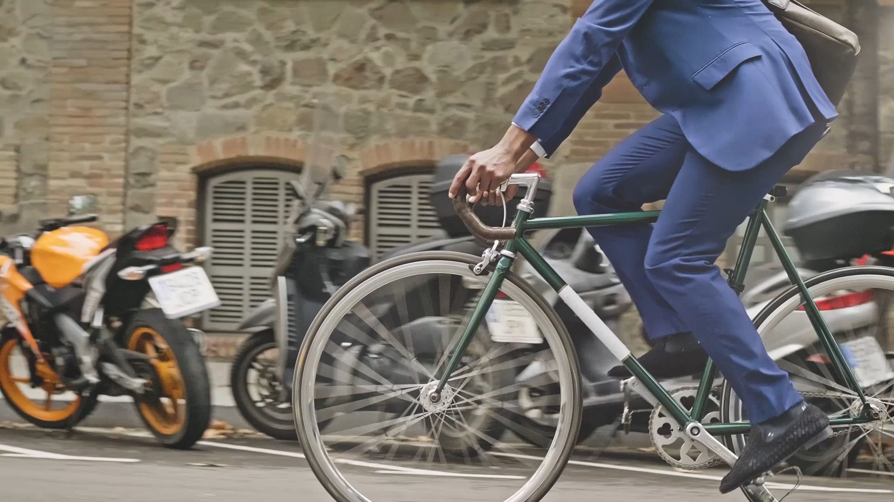
Getting on your bike
First of all, have a group chat and decide what you could do to make your cycle rides safer.
If you don’t ride a bike we still want you to give your ideas.
You are one of the I.M.P.S. team after all!
Write your ideas down and share them with the others in your group.

Slide 5
Things to do
Check you haven’t grown out of your bike.
Pump up the tyres and check for punctures.
Check that the brakes work.
Give it a clean and brush away the cobwebs.
Find your cycle helmet and make sure it still fits.
Find something reflective to wear in the dark.
Make sure your lights work.
Learn the highway code
Have a look at the next slide to find out how to check a bike is safe to ride.

Slide 6
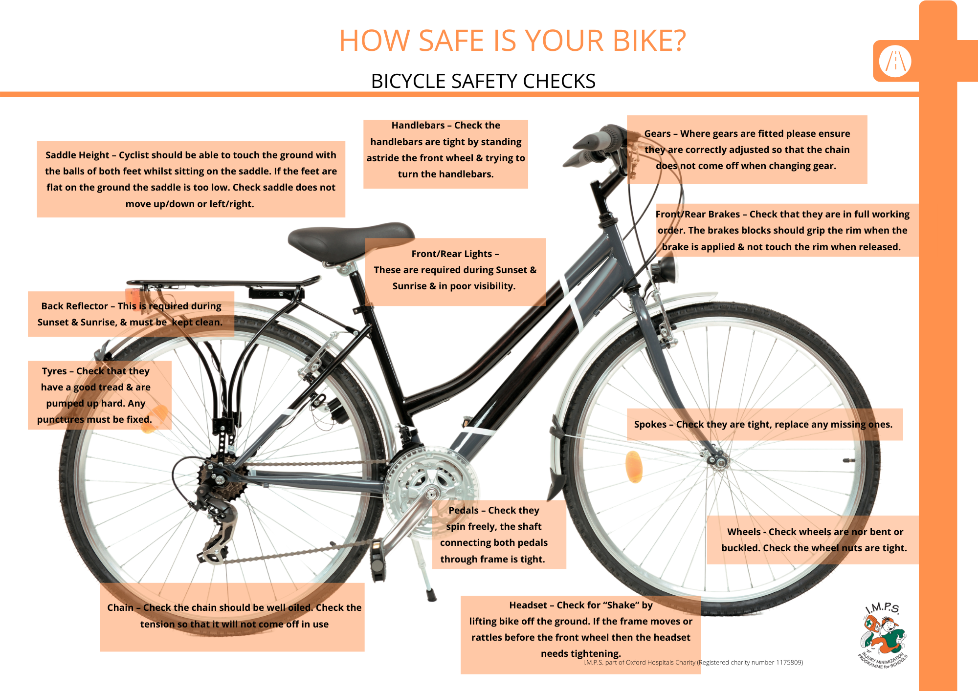
You can download a copy of this diagram

Slide 7
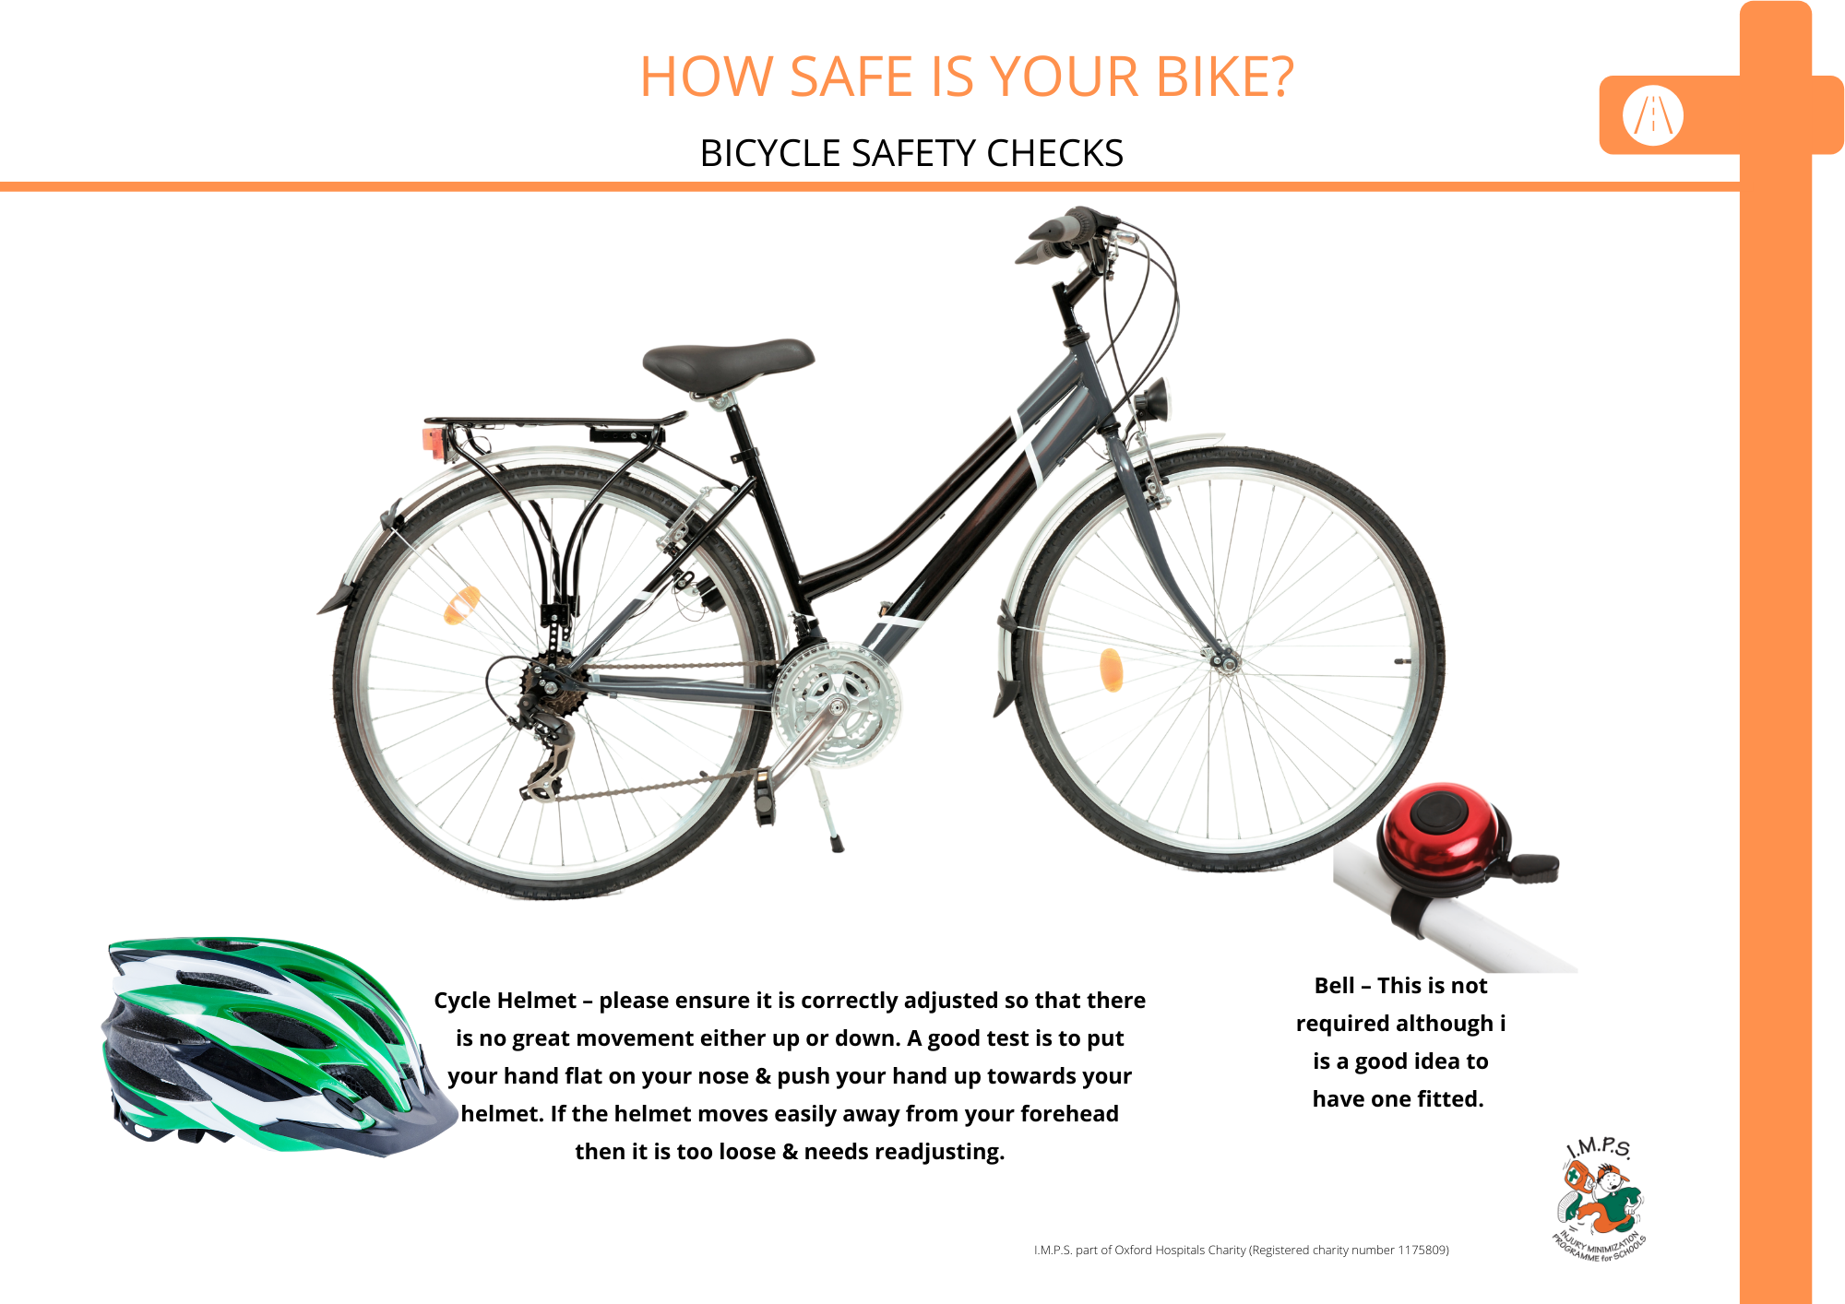
You can download a copy of this diagram

Slide 8
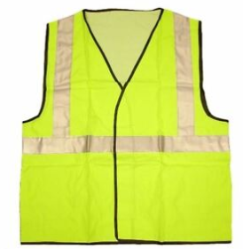
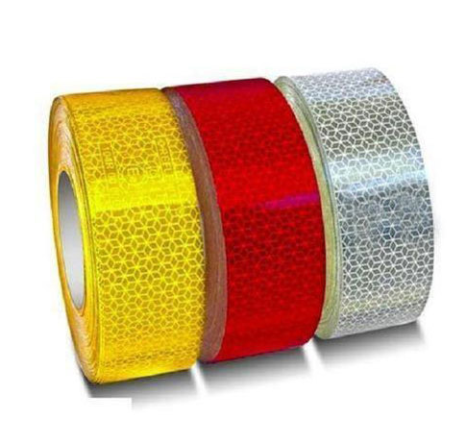
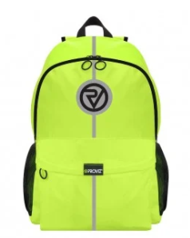
Be seen!
Even if it is the summer and the evenings are light it is still important to wear reflective and protective clothing as cyclists are not always visible to motorists.
Think of 3 things you could do to make yourself and your bike more visible.
Hi Vis vest
HI Vis tape
Hi Vis backpack

Slide 9
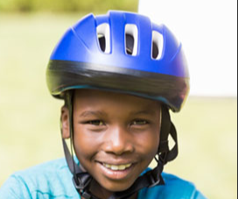
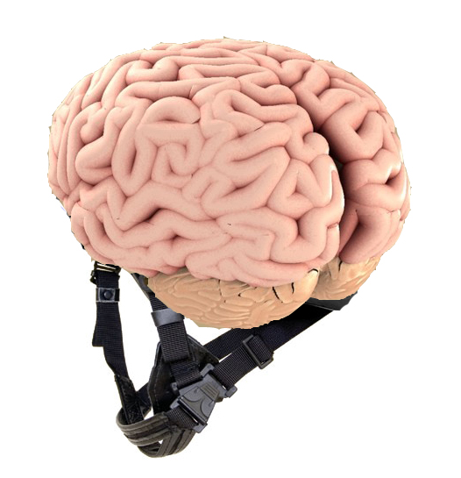
Look after your head!
How can you look after the most precious computer you will ever own? (your brain!)
Put it in a case (like your laptop and phone!)
Please wear a cycle helmet to reduce your risk of serious head injury and make a pact with your friends to always wear one.

Slide 10
Highway code for bikes
Don’t cycle past people walking at high speed.
Slow down and ring a bell or shout so people know you are there.
Remember that people walking may be deaf, blind or partially sighted.
Ride in the centre of the lane on quiet roads, in slower-moving traffic and at the approach to junctions or road narrowings.
Keep at least 0.5 metres away from the kerb edge when riding on busy roads with vehicles moving faster than you.
Vehicles must keep at least 1.5 metres away from cyclists when passing them.

Slide 11
Highway code
There is a new hierarchy of road users.
(That means in order of importance.)
Pedestrians.
Cyclists.
Horse riders.
Motorcyclists.
Cars/taxis.
Vans/minibuses.
Larger vehicles such as Heavy Goods Vehicles (HGVs) and buses.

Slide 12
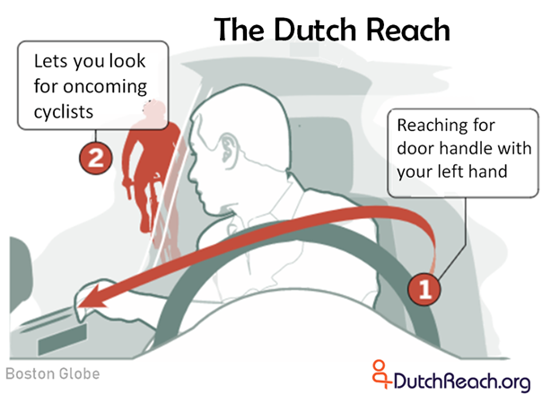
Have you heard about The Dutch Reach?
Just before we go we would like to ask you to pass on a really important message to
all the adults you know who drive a car.
It’s a way of getting out of a parked car to stop cyclists (and pedestrians) from being hit by car doors as they pass parked cars.
This short film will show you what we mean
https://youtu.be/WeM984dk220
Don’t forget to practise The Dutch Reach so you remember it when you are a passenger in a car!

Slide 13

Your mission
Be part of the I.M.P.S. team and help us to keep everyone safe.
Check your bike to make sure it’s safe to ride.
Make yourself and your bike visible.
Wear a helmet and make a pact with your friends to always wear one.
Explain the Dutch Reach to all the adults you know.
Let us know what sort of IMPact you make on safety.
Send us some photographs of what you do to make yourselves cycle safe.

Slide 14
Quiz
See if you can answer these short questions.
1. Name 3 things you can do to make your cycling safer.
Have a look at slide number 5 & 6.
2. Name 3 things to make yourself more visible on your bike.
Have a look at slide number 8.
3. What is the Dutch Reach?
Have a look at slide number 12.
4. In the new highway code hierarchy who is most important on the roads?
Pedestrians.

Slide 15

Thank you
Don’t forget to let I.M.P.S. know all about your missions!

Slide 16


