Slide 1

Defibrillators

Slide 2
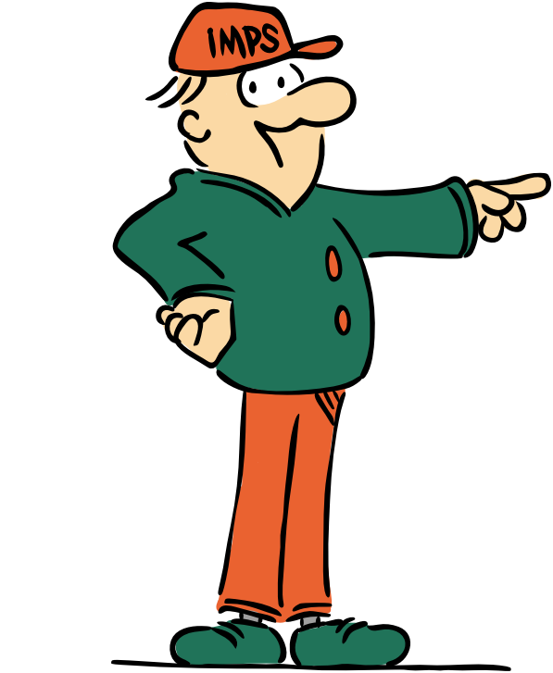
Welcome to the I.M.P.S. team!
Now you are in year 6 you automatically become a member of the I.M.P.S. team!
I.M.P.S. is a special programme that teaches you how to be responsible for the risks you take and how to make them safer. It also teaches you what to do in an emergency.
Every month we are going to give you an I.M.P.S. mission to complete. We would love it if you let us know what you do at your school and send us some images.
Find out more about I.M.P.S. at www.impsweb.co.uk Your teacher will do some lessons with you and book a visit from our I.M.P.S. trainers to teach you lots of useful emergency skills.

Slide 3

What is a defibrillator?
Have you ever heard of a defibrillator?
Can you guess what it is for?
If someone has a sudden cardiac arrest (when their heart stops beating properly) then CPR (pressing on the persons chest) will help to keep the blood circulating around the body.
A defibrillator is a bit like using Control, Alt and Delete on your computer when you need to reset it.
A defibrillator is a small portable machine with its own battery that safely delivers an electric shock to make the heart start beating properly again.
Anyone can use a defibrillator and you will learn to use one when you have your I.M.P.S. session with our trainers.

Slide 4
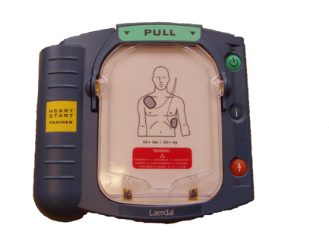
AED
A defibrillator is sometimes called an AED.
Do you know what AED stands for?

Slide 5
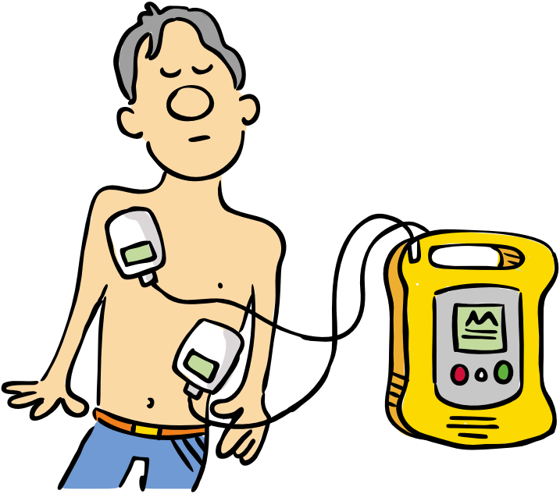
AED
Automated – it tells you what to do.
External – you put it on the outside of a body.
Defibrillator – it ‘reboots’ the heart (just like Ctrl, Alt, Delete on your computer.)
If you can use a defibrillator within 3-5 minutes of collapse the survival rate increases to 50-70%.

Slide 6
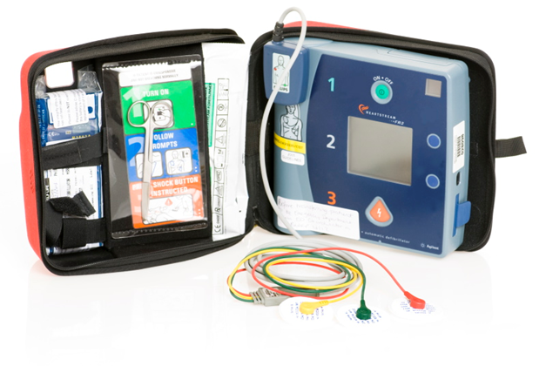
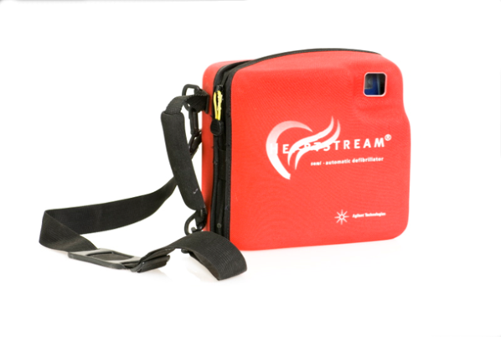
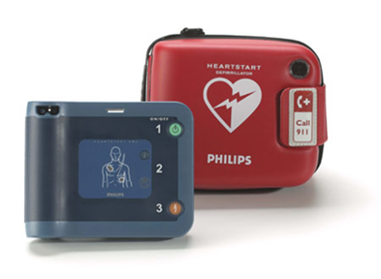
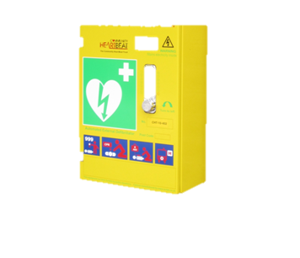
What does an AED look like?
We would like you all to become AED spotters
AED’s come in different designs (just like mobile phones).
They all work in the same way.
You switch it on, attach the pads and follow the instructions.

Slide 7
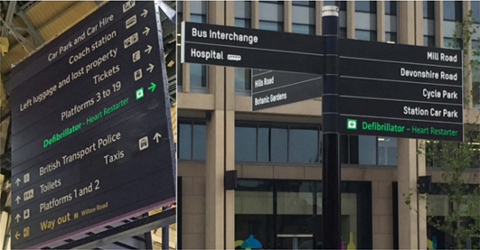
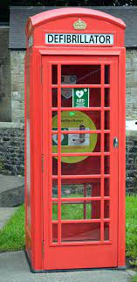
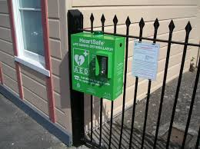
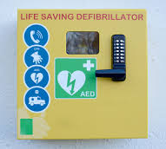
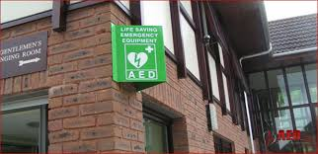
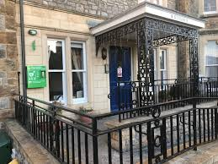
Where are they kept?
An AED can be situated
inside or outside.
Some are kept inside
cabinets or telephone
boxes.
As a class write a list of all
the places where you could find an AED.
What do all the AED’S have in common?

Slide 8
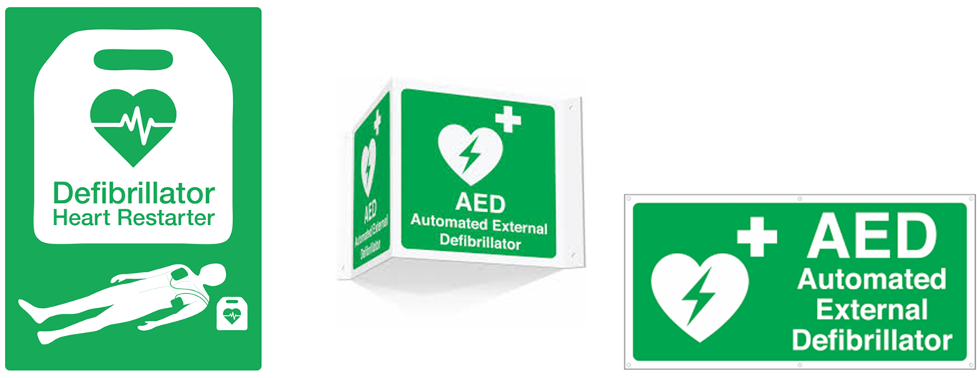
They all have signs that tell you where an AED is located.
The sign will look like one of these.

Slide 9
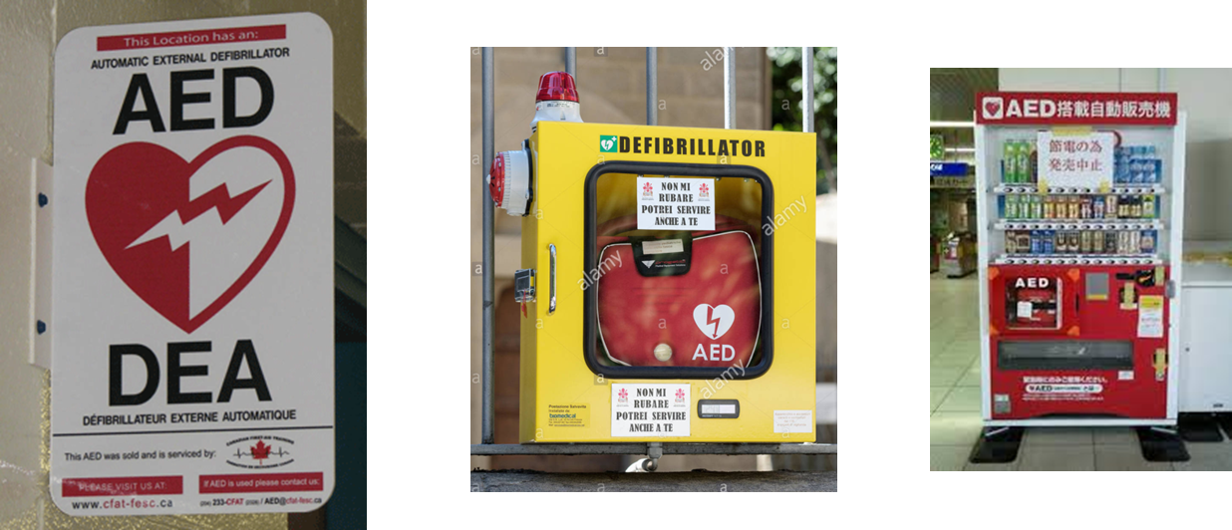
Do they have AED’s in other countries?
Yes they do! They all work in exactly the same way.

Slide 10
Your mission
Spot an AED when you are out and about.
If you can, take a photograph of the AED and write down the location.
Draw a map of your local area and mark the position of the AED’s on it.
Add a copy of your photographs to the map showing an image of the AED.

Slide 11
Remember
Find out where the nearest AED is whenever you go out.
You can NEVER do anyone or yourself any harm by using an AED.
If the person does not need an AED the AED will not give them a shock.
If you think your community needs more AED’s then write to your local council with a copy of your findings.
You will all learn how to use an AED with I.M.P.S.
If your school does not own an AED already, ask your teacher to follow this link for more information. https://www.gov.uk/government/news/every-school-will-have-a-life-saving-defibrillator-by-2223

Slide 12
Quiz
What does AED stand for?
Automated External Defibrillator
Who can use an AED in an emergency?
Anyone can use an AED. It’s really easy, just switch it on and follow the instructions.
When do you use an AED?
If someone has collapsed and you think they may have suffered a sudden cardiac arrest.
(they are unconscious and have stopped breathing)
Don’t worry – you can’t do anyone any harm by using one.

Slide 13

Did you know?
If you have an Alexa at home and you say
“Alexa activate emergency CPR”
you can practise on a cushion or a teddy.
(remember NEVER phone 999 unless there is a real emergency or practise CPR on a person who is breathing)

Slide 14

Thank you
Don’t forget to let I.M.P.S. know all about your missions!

Slide 15


